Slide 1
Effective Java
Sagar Kulkarni

Slide 2
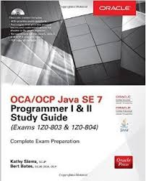
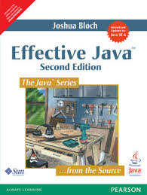
www.enthuware.com
www.pluralsight.com

Slide 3
Agenda
Class loading
Object Creation
Exception Handling
Collection framework

Slide 4
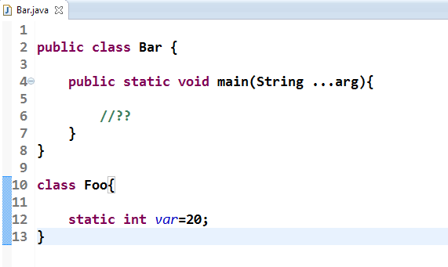
When does static variable get created?

Slide 5
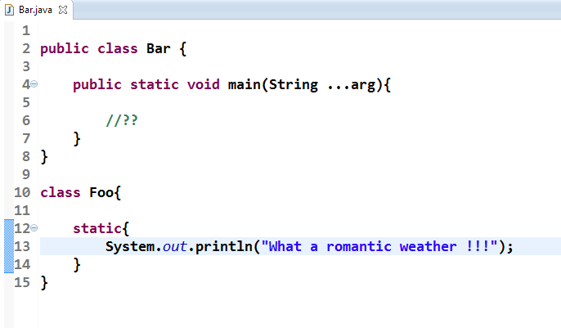
When does static block get executed?

Slide 6
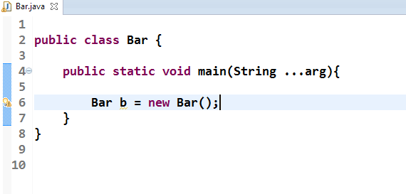
Who is the object here?

Slide 7
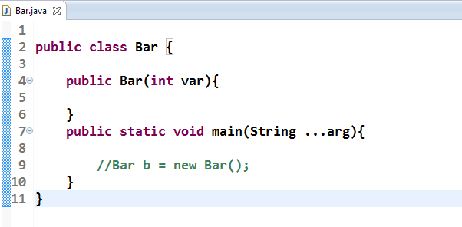
Is default constructor always provided?

Slide 8
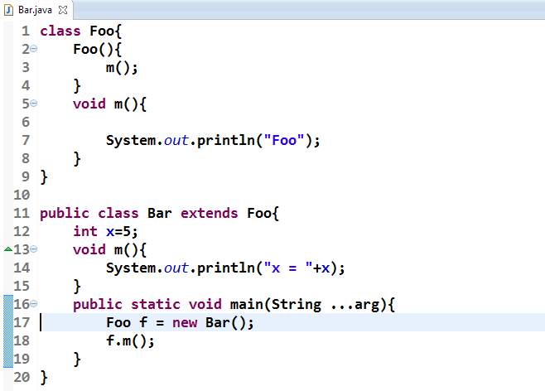
Super class constructor is always called.

Slide 9
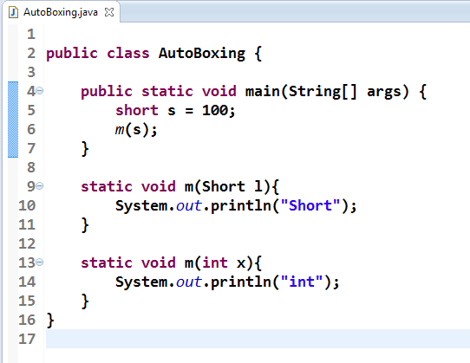
Autoboxing

Slide 10
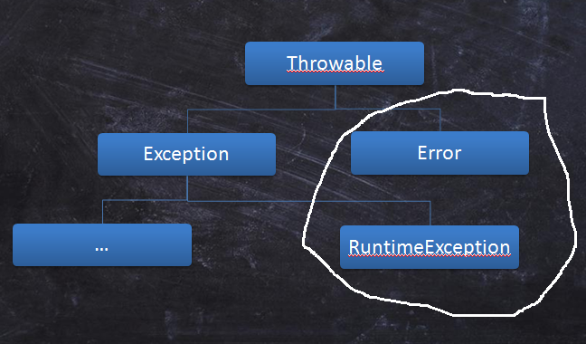
Checked / Unchecked ?

Slide 11
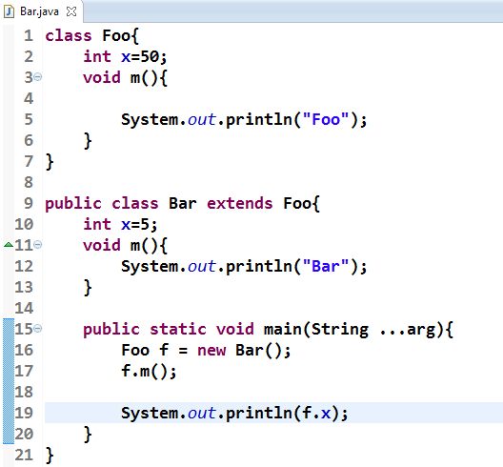
Overriding V/S Shadowing

Slide 12
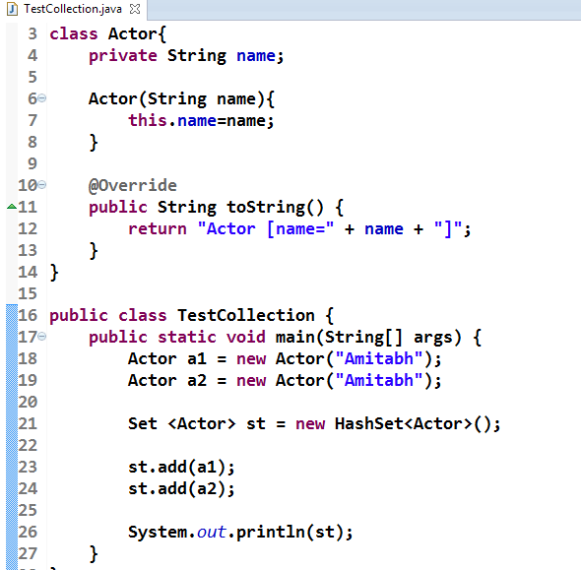
Collection Framework

Slide 13
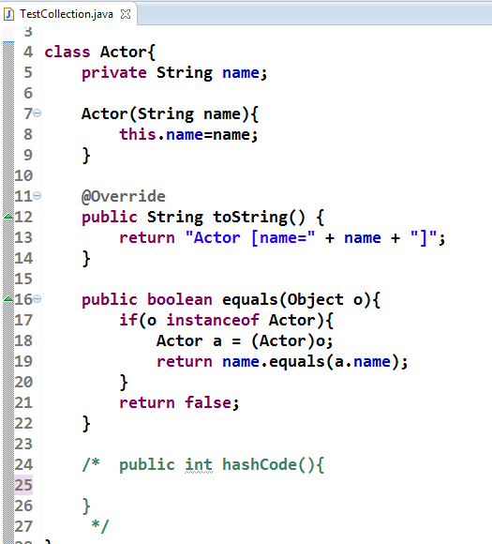
Significance of equals() & hashCode()

Slide 14
hashCode Contract
If two objects are equal according to the equals(Object) method, then calling the hashCode method on each of the two objects must produce the same integer result.

Slide 15
equals Contract
reflexive
symmetric
transitive
consistent

Slide 16
Comparable / comparator
How will you add legacy objects in a HashSet – which have not overridden equals() & hashcode() methods, and are not comparable?

Slide 17
Thank You
Sagar Kulkarni
Sagar.a.kulkarni@capgemini.com
9850276767

